Slide 1
Brief Introduction to Angular
Lim Jia Wei

Slide 2
Prerequisite
Node.js and NPM
Angular CLI
  npm install -g @angular/cli

Slide 3
Generating a new project
A new angular project can be generated using the Angular CLI command:
  ng new <project-name>
After the project is generated, we can use ‘ng serve’ to view the newly created application on localhost:4200

Slide 4
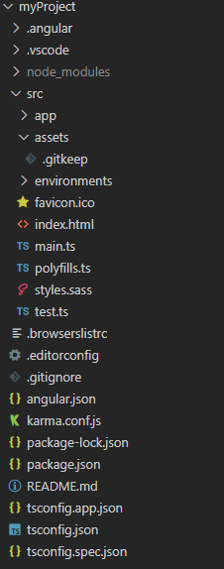
Project Structure
src - source code
  app
    Contains the root of the app and where the pages are stored. Any new components are generated here as well.
  assets
    Stores any assets to be displayed on the application, such as images
  environments
    Configurations for different development environment, e.g. production and development
  index.html
    Default app of the project
  main.ts
    main method of the project

Slide 5
Project Structure
angular.json
  Angular configurations
package.json
  Packages or dependencies
tsconfig.json
  TypeScript configuration

Slide 6
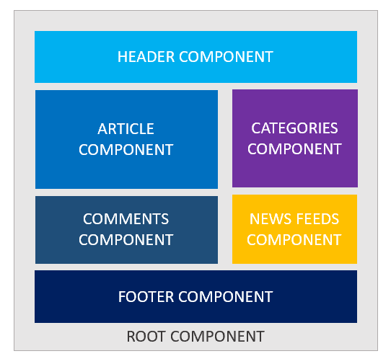
Components
Components are the main building block for Angular applications
Each component consists of:
  An HTML template that declares what renders on the page
  A TypeScript class that defines behavior
  A CSS selector that defines how the component is used in a template

Slide 7
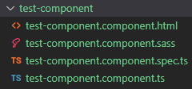
Generating a new component
Using Angular CLI
  ng generate component <componentName>
  New folder is created in src/app

Slide 8
Angular Features
Template Syntax
Displays data dynamically on HTML page as strings
Syntax is double curly braces ‘{{ }}’
Use cases:
  String Interpolation
    Display variables on HTML page
  Evaluate Expressions

Slide 9
Angular Features
Directives
An instruction to the DOM
Types of Directive:
  Structural Directive
    Changes view of webpage by manipulating DOM elements
    *ngFor , *ngIf
  Attribute Directive
    Changing an element’s look and behavior

Slide 10
Angular Features
Data Binding
Data binding is the communication between the TS file and HTML
Two types of Data Binding:
  One-way where the binding unidirectional. Either from View to Component or vice versa.
  Two way binding where synchronization of data happens between the Model and the View.

Slide 11
Angular Features
Data Binding : One-way
Component to view
  Interpolation
  Property Binding
    Set values for properties of HTML elements or directives. Use property binding to do things such as toggle button functionality, set paths programmatically, and share values between components.
View to Component
  Event Binding
    Event binding lets you listen for and respond to user actions such as keystrokes, mouse movements, clicks, and touches.

Slide 12
Angular Features
Data Binding : Two-way
  Two-way binding gives components in your application a way to share data. Use two-way binding to listen for events and update values simultaneously between parent and child components.
  Syntax is a combination of square brackets and parentheses, [( )]

Slide 13
Data sharing between Parent and Child Component
@Input() decorator enables a component to take in input values.
@Output() decorator

Slide 14
Services
A form of dependency injection to decouple functionalities with specific components
Use cases includes implementing commonly used methods and API calls between components
To generate a new service, we can call the “ng generate service <name>” command

Slide 15
Routes
Used for navigating the application and changes the view. Each route corresponds to a URL.
Angular inserts the components associated with a route through the “<router-outlet>” HTML tag. Elements outside of the tag will not be changed.
When there are similar route names, route order plays a role as well.
There are other features with Routes as well, such as:
  Route Parameters
    Named URL segments that are used to capture values specified at their position.
  Route Guards
    Grants User access to specific routes depending on conditions
  Wildcards
    Matches any routes, commonly used for error pages when no other routes are found.

Slide 16
Routes
Re-direction
Navigation can be done through the HTML page using router-link property binding
Or programmatically by importing the Router module

Slide 17
Routes
Parameters
To use route parameters, the syntax “<name>/:<param name>” needs to be added to the path.
  For example: “user/:id”, where “id ” would be the route parameter name
To access the parameters in a component, the ActivatedRoute module is needed.

Slide 18
Routes
Guard
To use guards, we need to generate a service with “ng generate guard <name>”
Within the service, we can choose from a few route guard methods to implement. In this case we’ll select the “canActivate” method.
After implementing the method, we need to invoke the guard in the routing module.

